Slide 1
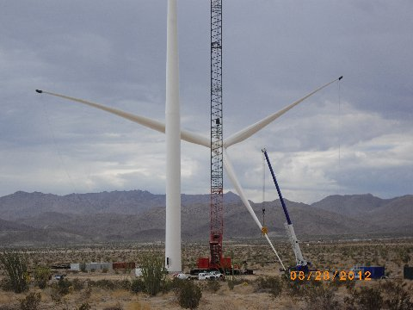
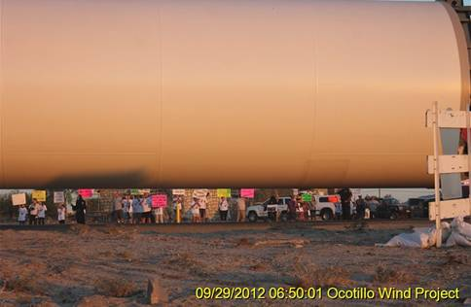
GONE WITH THE WIND?
Impacts of industrial wind projects on our region and our world

Slide 2
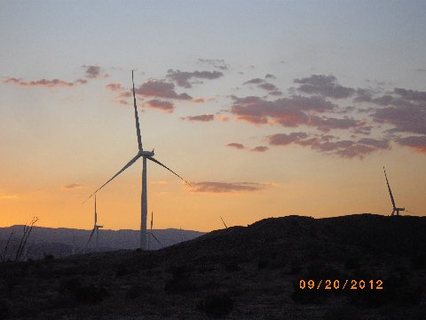
Isn’t wind energy clean and green?
Wind is a renewable resource. But like nuclear, once touted as clean because it doesn’t use fossil fuels or pollute the air, wind power has hidden consequences.

Slide 3
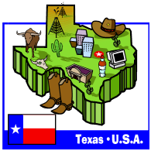
Nationally, 376 million acres of our public lands are targeted for large-scale renewable energy projects. That’s twice the size of Texas!
20 million acres of that is industrial wind and another 20 million acres is large-scale desert solar, mainly here in the southwest. The majority is geothermal, which can include fracking, and some biofuels.

Slide 4
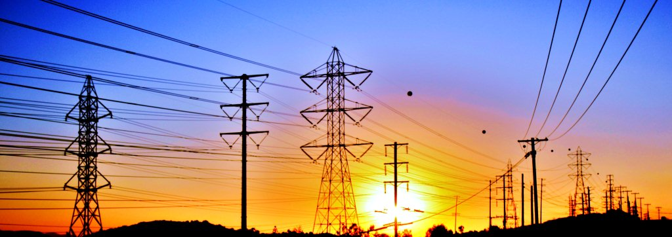
Over 50 large-scale wind and desert solar projects are proposed in San Diego’s East County and neighboring Imperial County. Some are in Cleveland National Forest or other scenic areas, such as Santa Ysabel near Julian, McCain Valley, Ranchita, and Mt. Laguna.
These projects also need new roads, substations and power lines.
Is this the energy future that we want—or need--for our region?

Slide 5
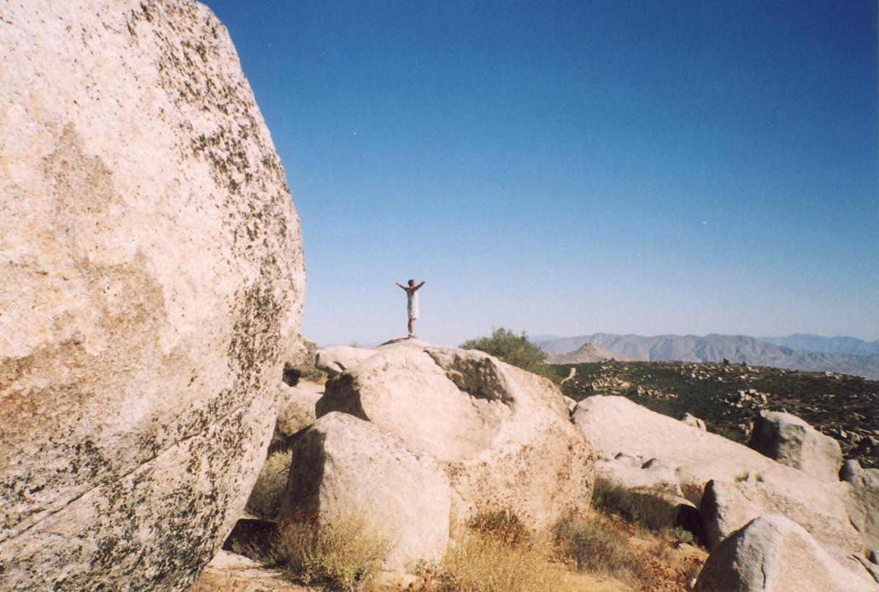
County Supervisors are set to consider a wind ordinance Dec. 5 that would make it easier to build industrial-scale wind projects in much of East County.
Already, the Bureau of Land Management and the County have approved Tule Wind, which will destroy beautiful McCain Valley.

Slide 6
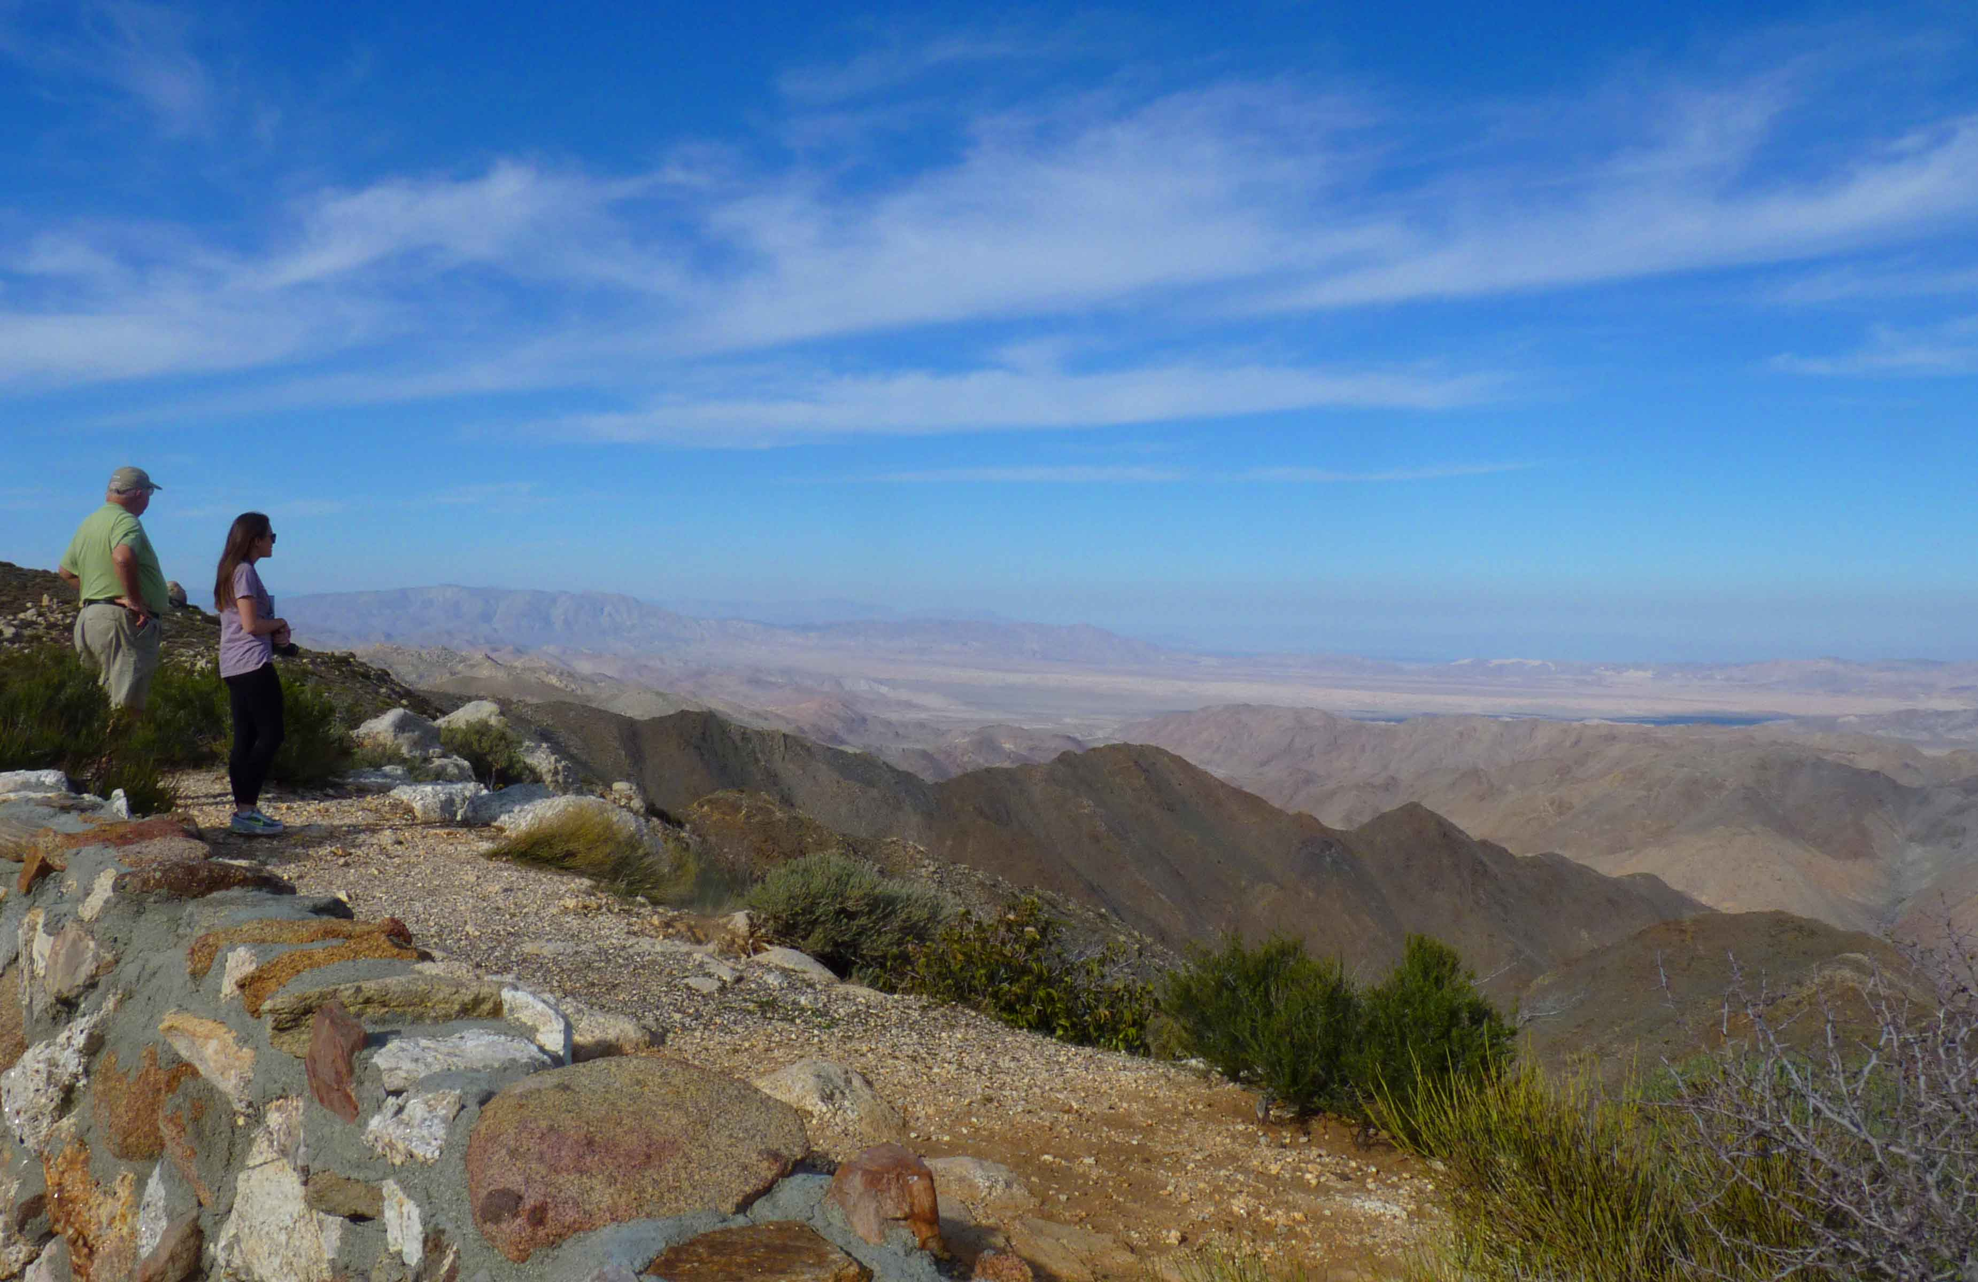
McCain Valley is our land—set aside for public recreation. It is the gateway to three federal wilderness areas including the spectacular Carrizo Gorge. Locals call it “our Grand Canyon.”

Slide 7
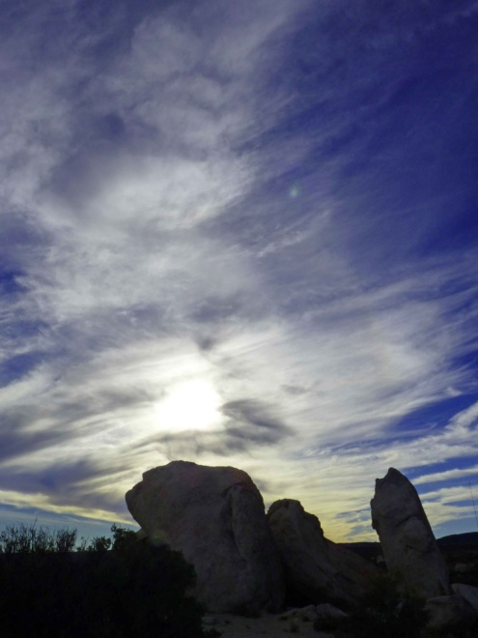
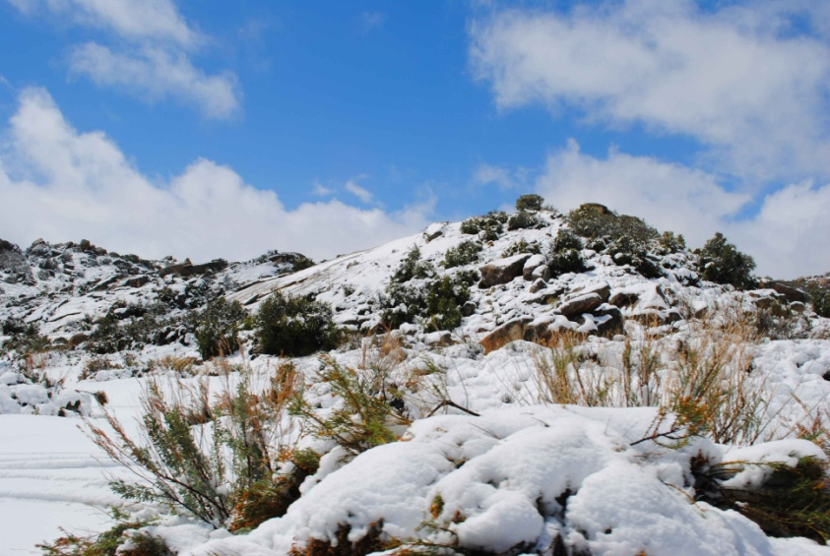
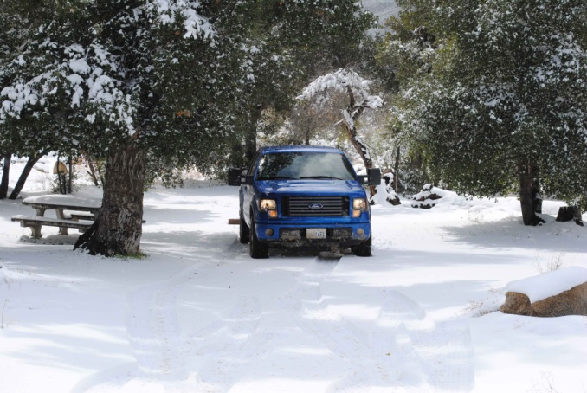
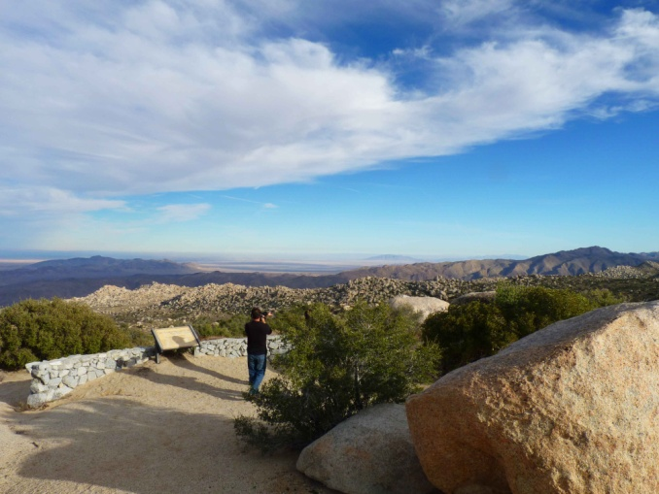
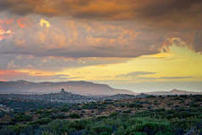
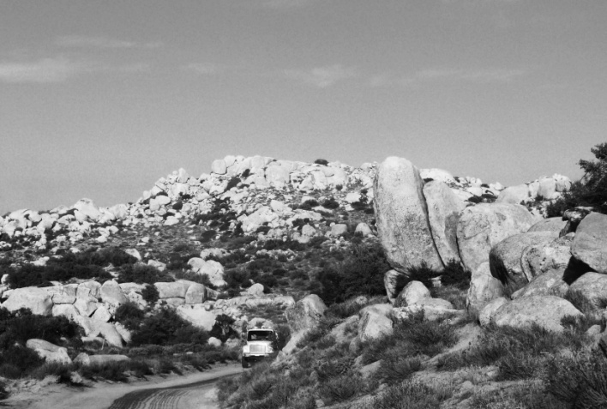
This is what we’re losing in McCain Valley.

Slide 8
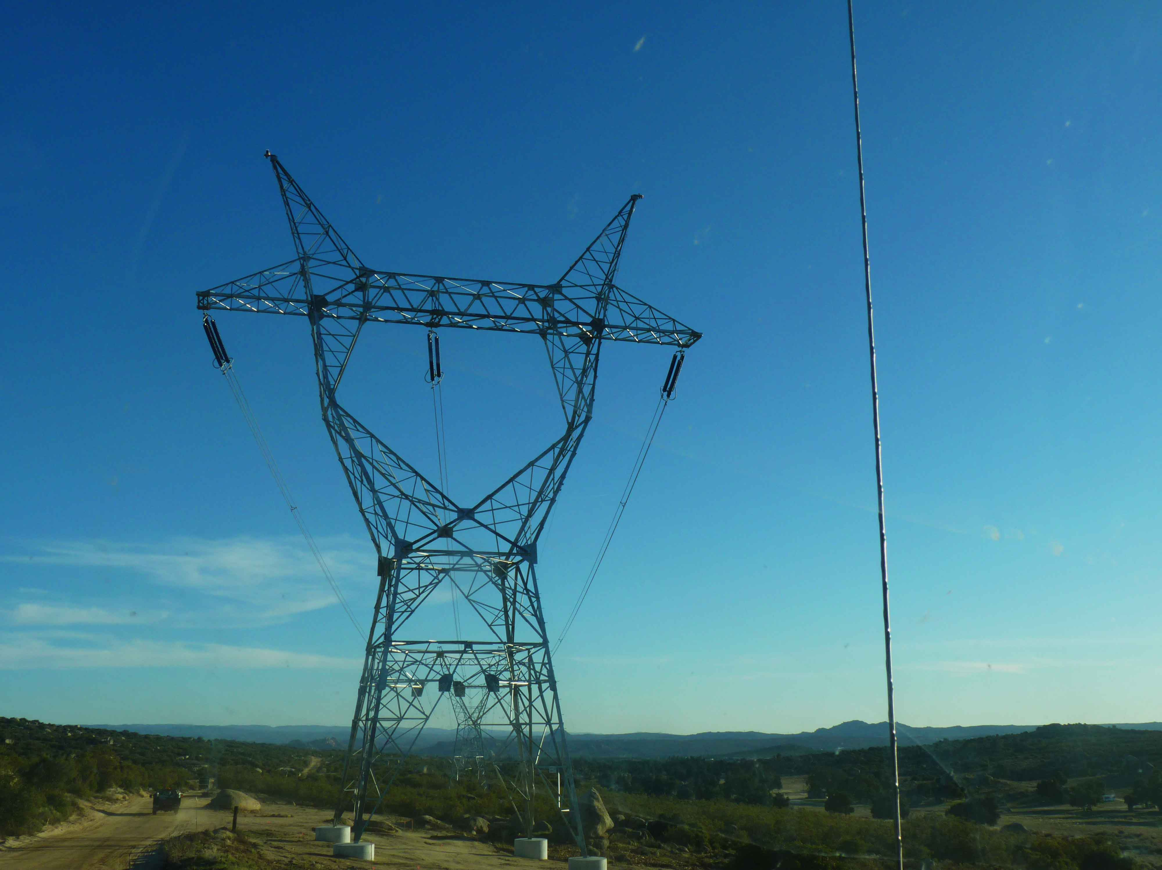
Soon it will be filled with 100 or so wind turbines, each nearly 500 feet high. That’s over twice as tall as Powerlink, which was added in a portion of the valley.

Slide 9
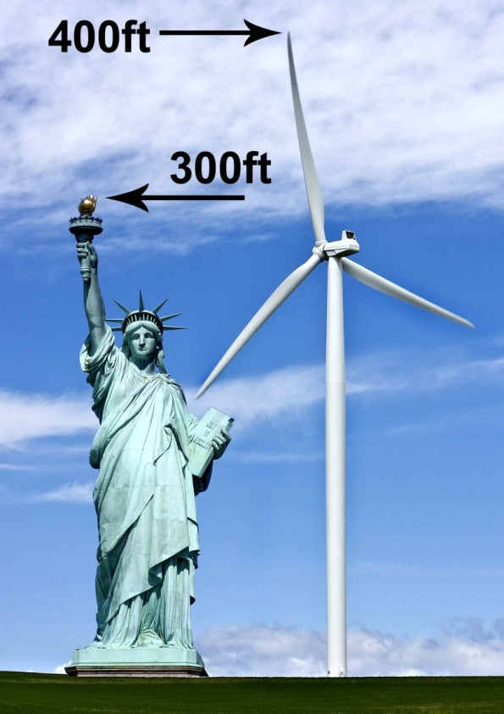
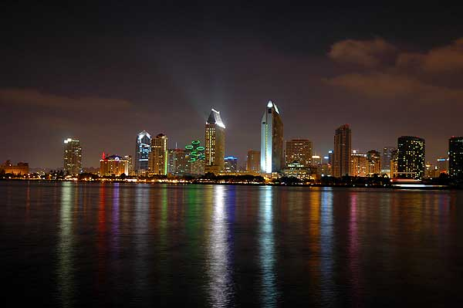
How big are the turbines?
Taller than the Statue of Liberty. Taller than the highest building in downtown San Diego.

Slide 10
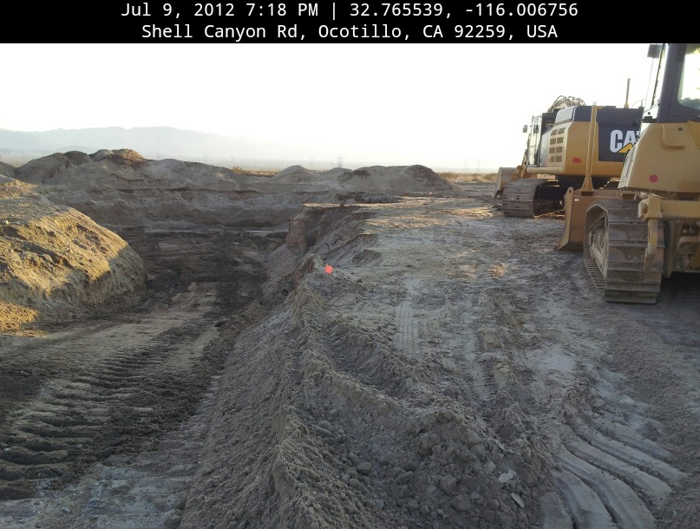
Each turbine has a blade span wider than the wings of a 737 jetliner– about the size of a football field. Each foundation hole is 238 feet wide. The destruction is huge. Doest this look green to you?

Slide 11
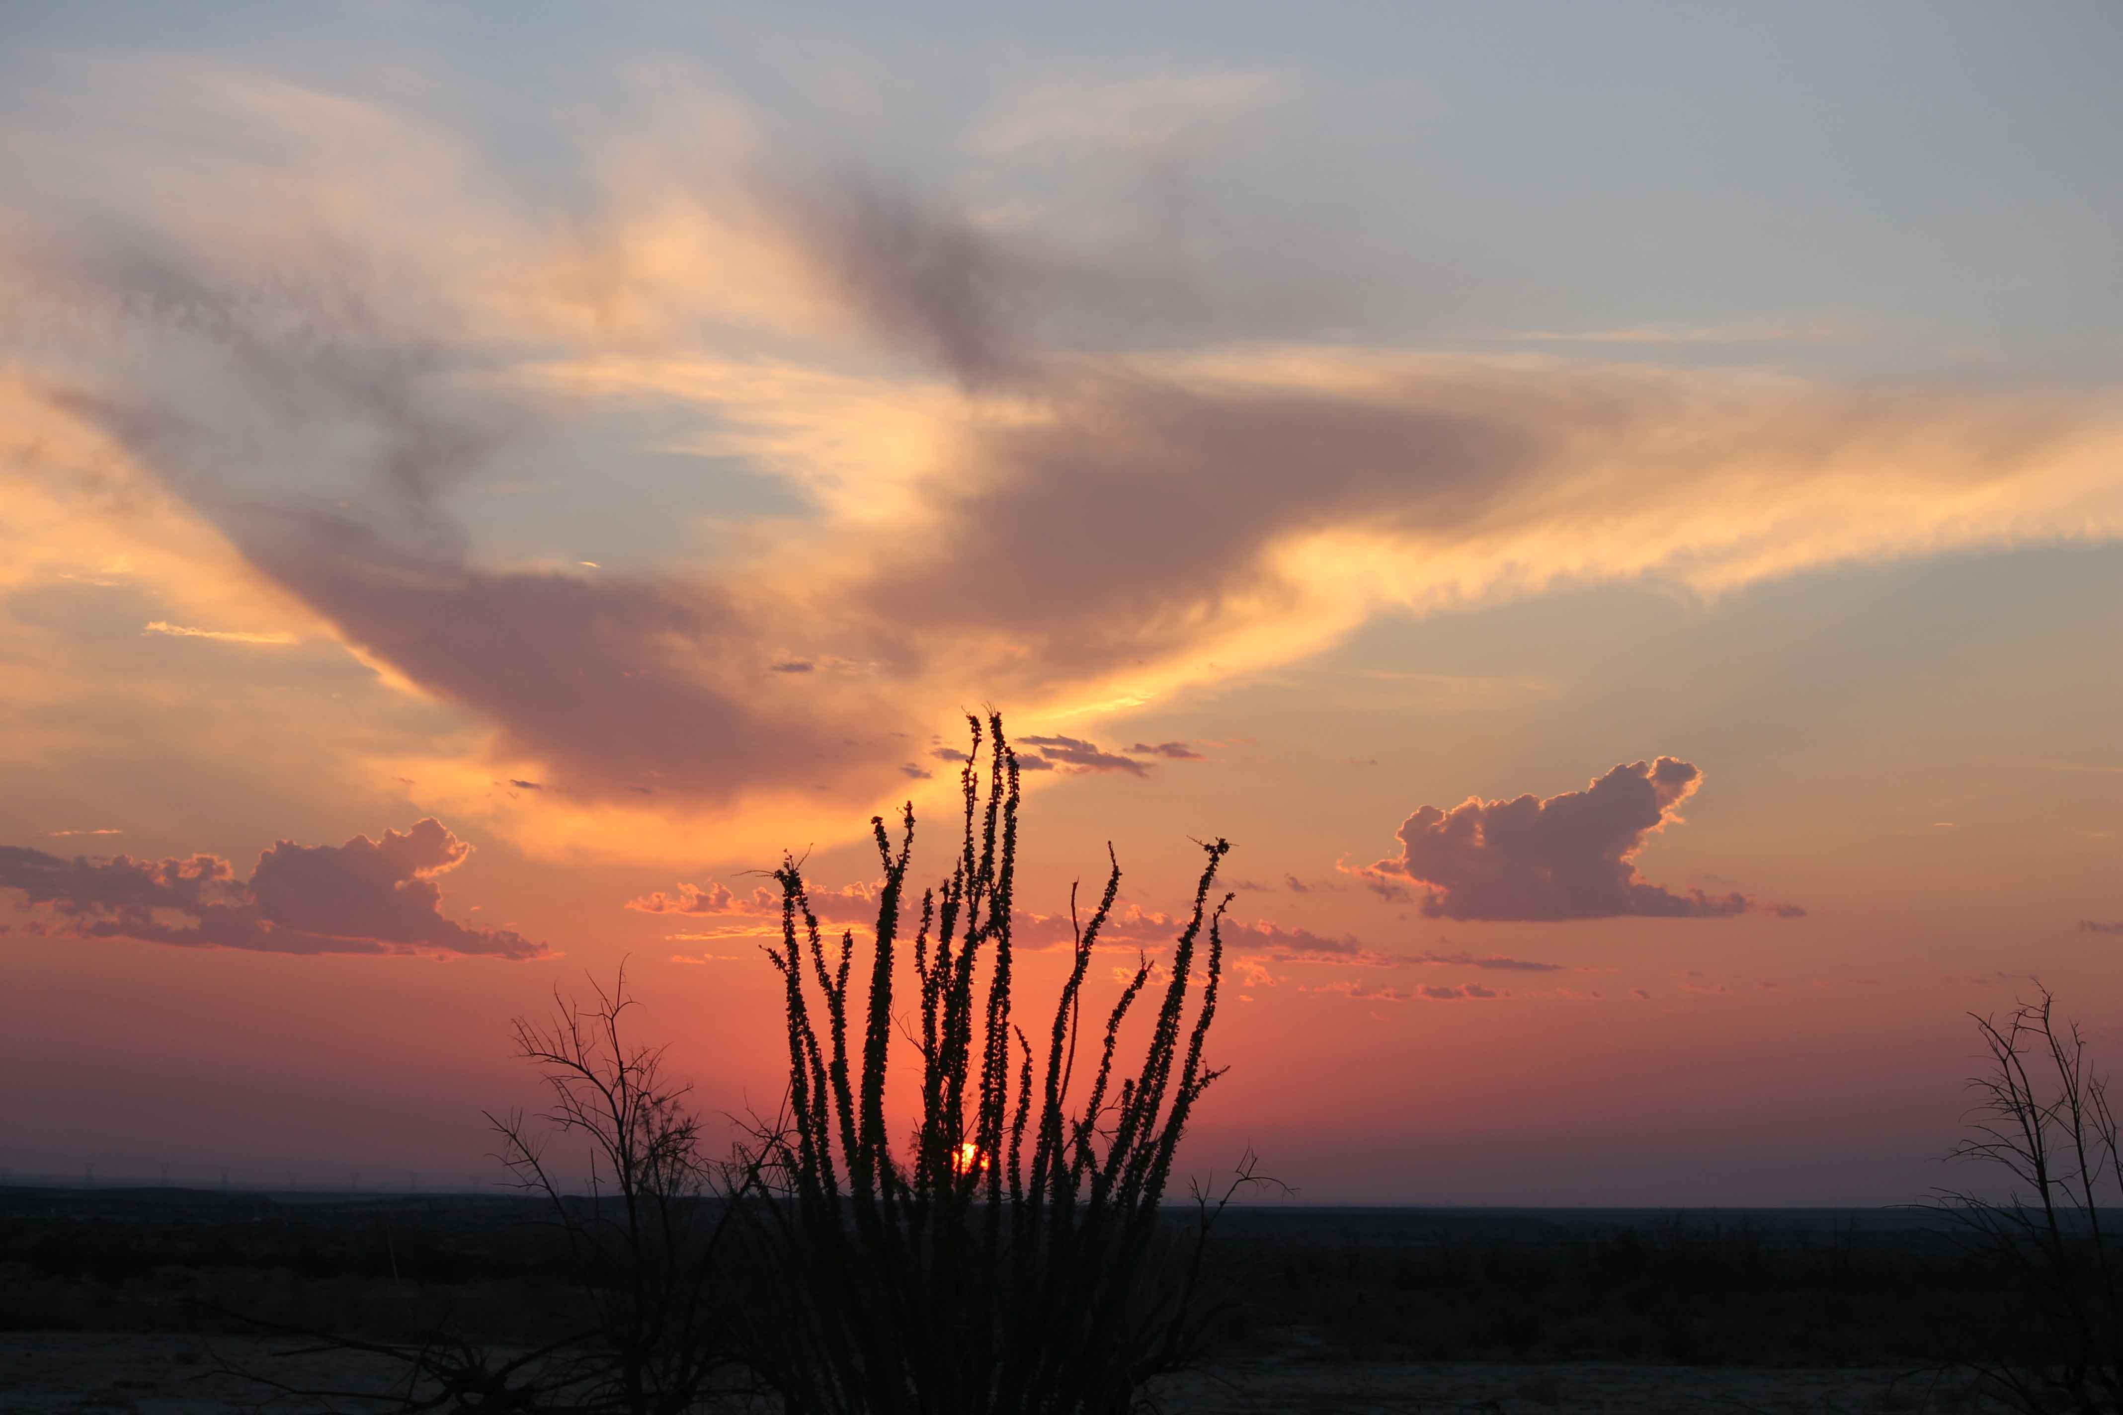
Ocotillo is ground zero.
12,400 acres are being destroyed on our public land.

Slide 12
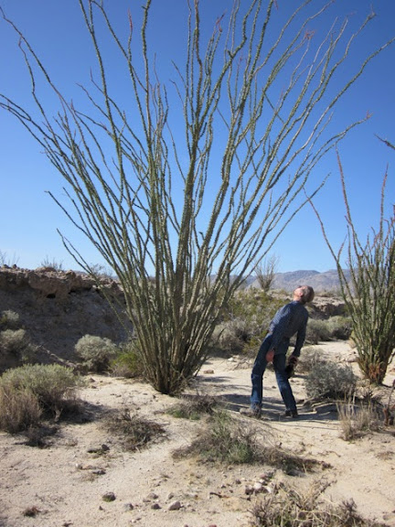
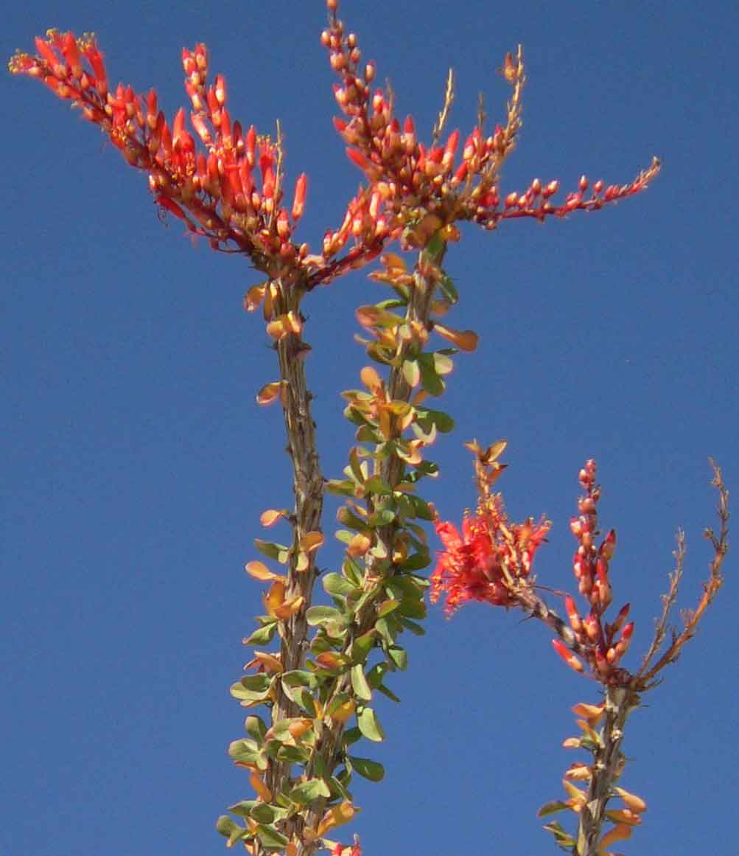
These century-old ocotillos have been bulldozed.

Slide 13
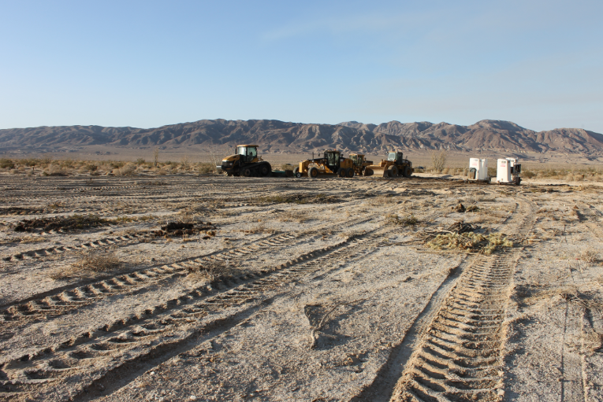
Pattern Energy claimed it would be “minimal impact”

Slide 14
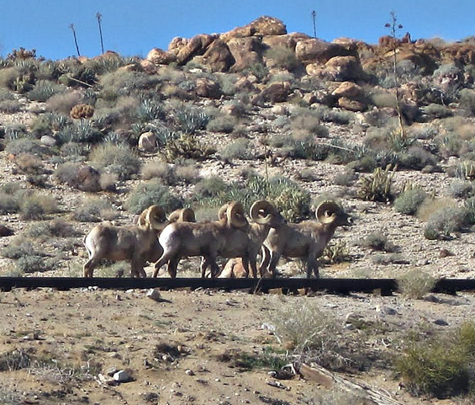
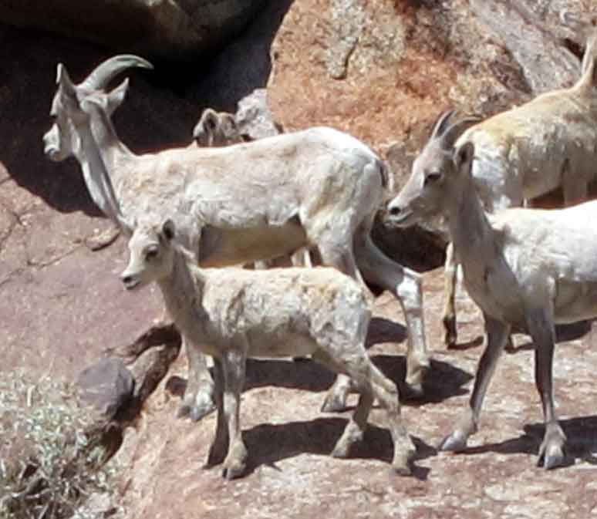
Nothing could stop this project with the new federal fast-tracking process. First they claimed no endangered bighorn were there. When we sent photos proving they were, Secretary of the Interior Ken Salazar issued take permits allowing Pattern to kill them. There are only about 900 of these beautiful animals left.

Slide 15
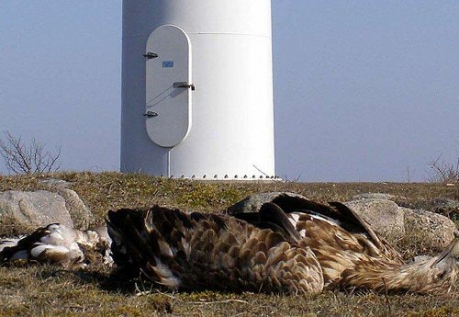
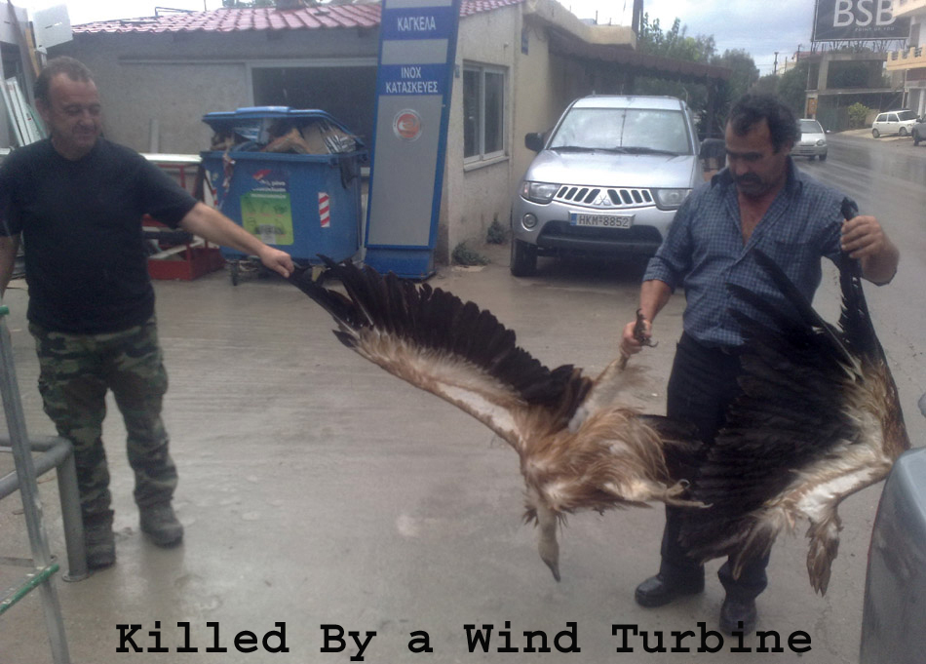
McCain Valley is habitat for both bighorn sheep and golden eagles. Take permits are likely, since turbines’ sharp blades slaughter birds. Altamont wind farm alone has killed thousands of golden eagles. Save the Eagles says California’s eagle population verges on collapse due to wind turbines. Birds suffer terribly, with wings cut off and worse. The industry claims radar can protect birds and shut down turbines, but can’t produce a single video to prove it’s ever worked, anywhere.

Slide 16
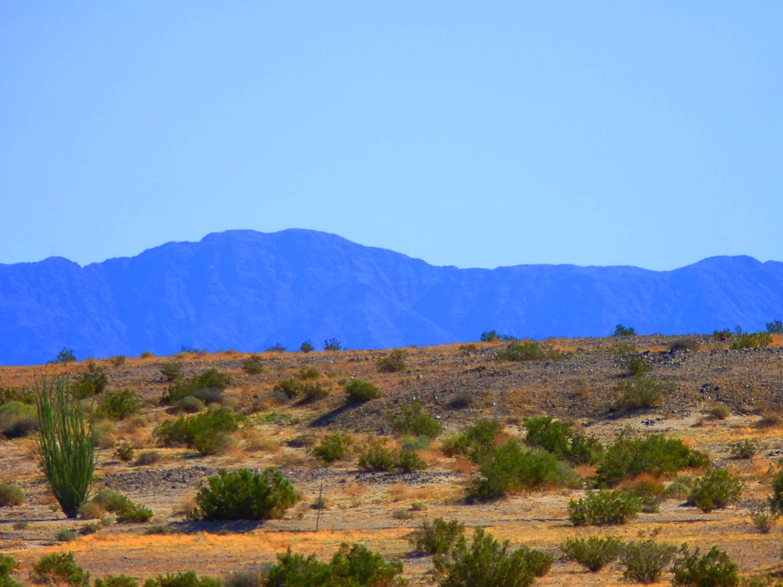
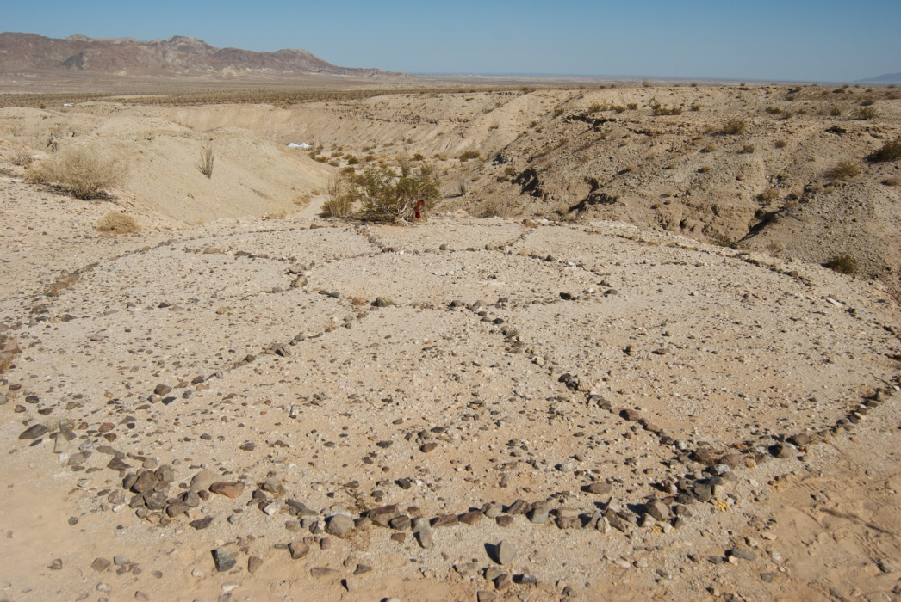
Across America, Native American sacred sites are being sacrificed for “green” energy – and promises to tribes are being broken. Places like this ancient spoke wheel geoglyph, “protected” on the National Registry of Historic Places, are being desecrated. So are graves of their ancestors and Coyote Mountains, which they believe is where creation began.

Slide 17
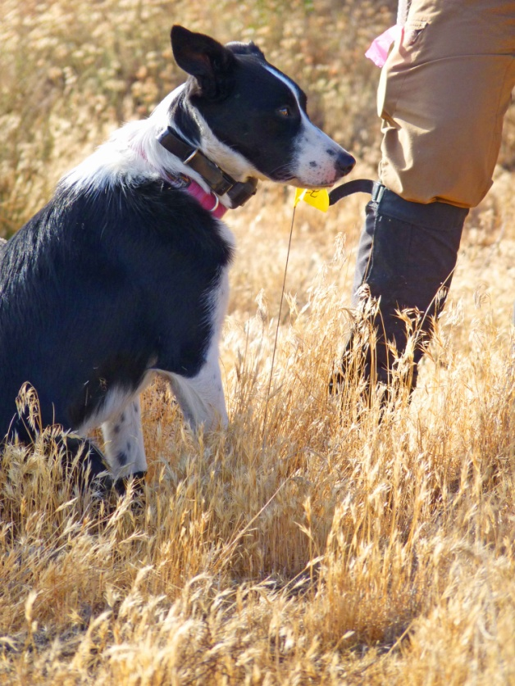
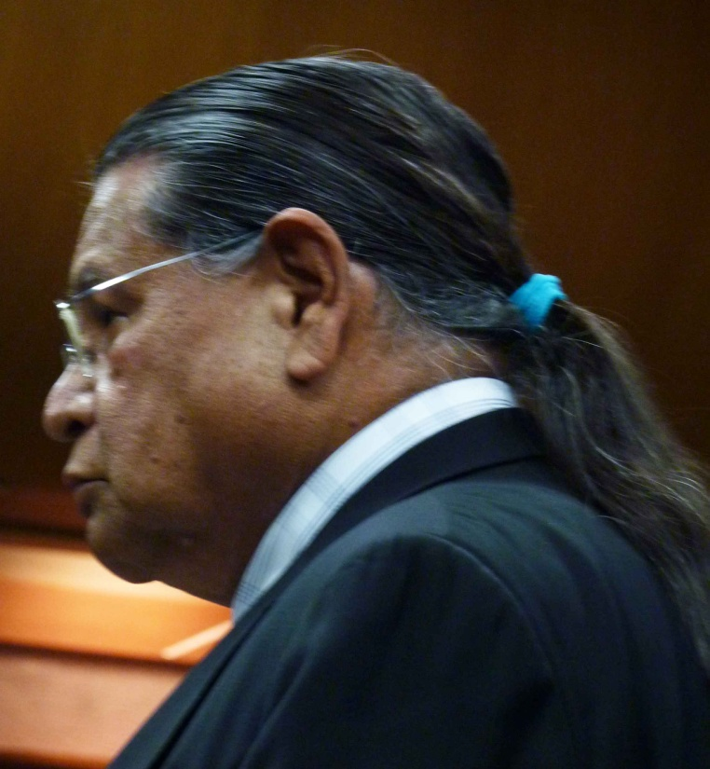
Pattern refused to check for ancient burial sites. So Indians hired forensic dogs. In a couple of days they found 50 sites in Ocotillo, which means Valley of the Dead and others in McCain Valley. A judge refused to issue a temporary restraining order . The BLM wouldn’t call the Coroner to confirm human remains. Pattern keeps building. The Indians are heartsick.

Slide 18
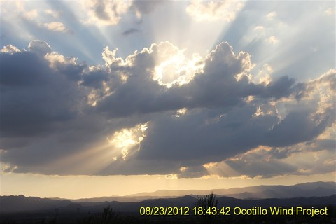
The Inspector General for the U.S. Dept. of the Interior issued a scathing report accusing the Bureau of Land Management of failing to provide proper oversight on big energy projects.

Slide 19
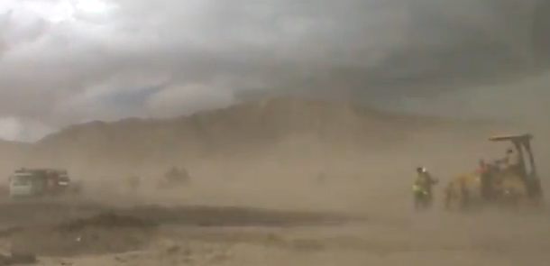
In Ocotillo, they broke all the rules. Nobody did anything. The EIR required dust control. Water trucks only showed up if citizens came with cameras. The dust here carries deadly Valley Fever spores. Does this dust bowl look safe for residents or workers?

Slide 20
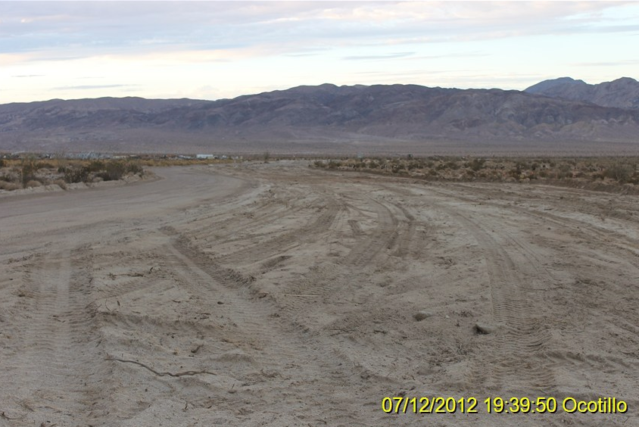
The EIR allowed 42 miles of new roads, up to 36 feet wide. But Some were built over 100 feet wide. Everyone complained, same with the dust, but nothing was done. So called “monitors” are turning a blind eye to blatant violations. They are paid by Pattern.

Slide 21
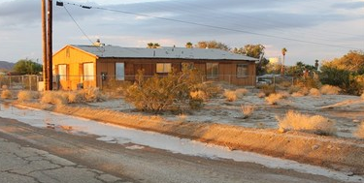
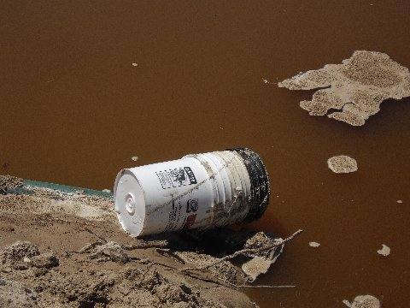
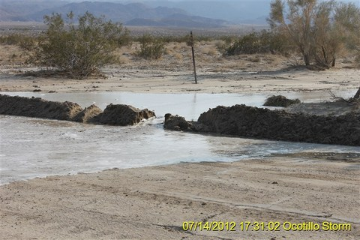
Pattern diverted drainage without authorization. The result? They flooded the town of Ocotillo—with a FLAMMABLE white chemical on people’s lawns where children play! They also spilled or dumped chemicals over the aquifer, the town’s only source of drinking water. No cleanup was ever done.

Slide 22
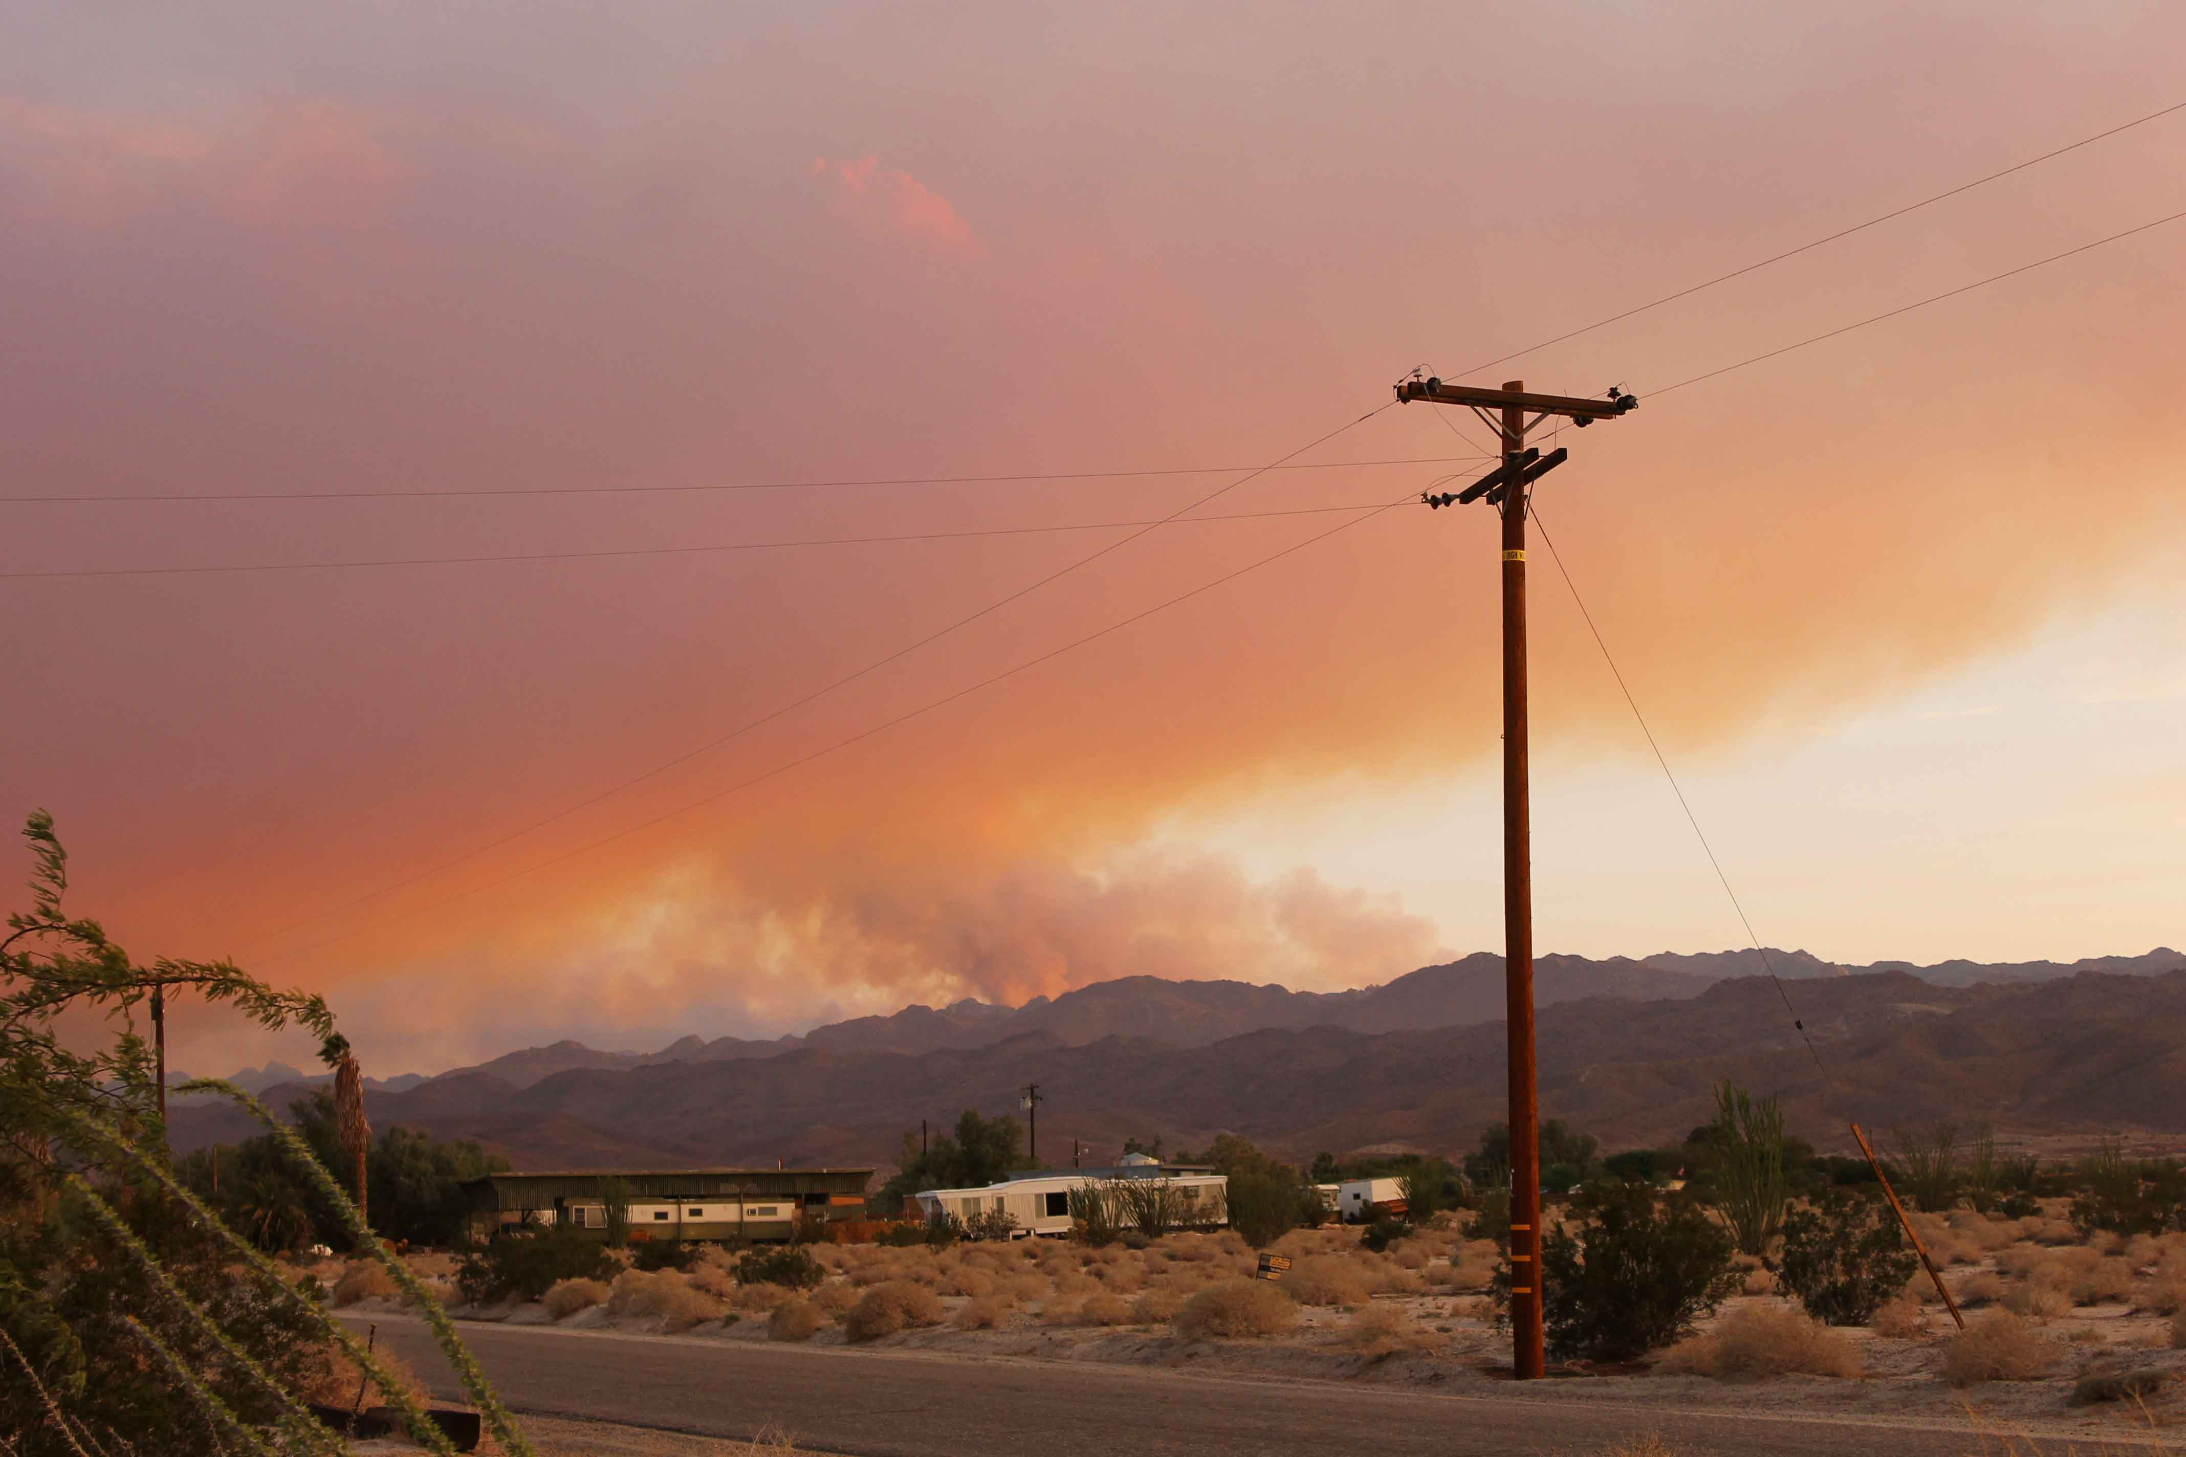
Just days later, the Vallecitos Lightning Fires ignited the mountainside behind Ocotillo. What if a spark had blown onto all that flammable white chemical residue?

Slide 23
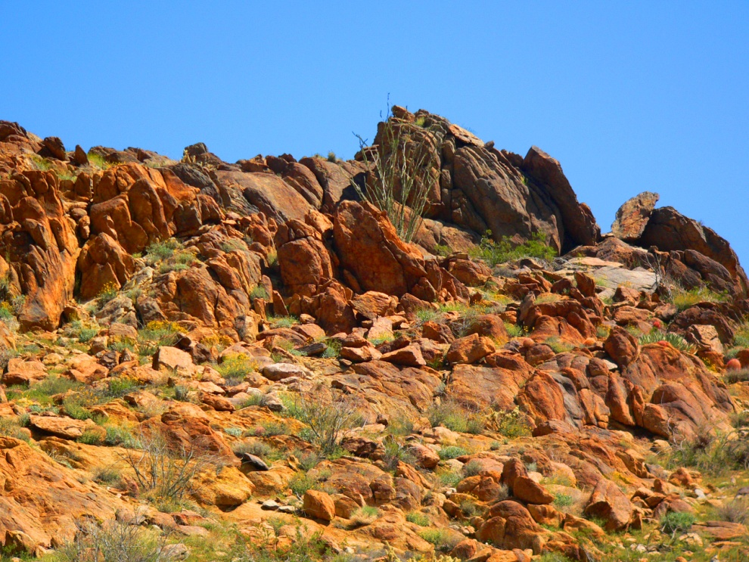
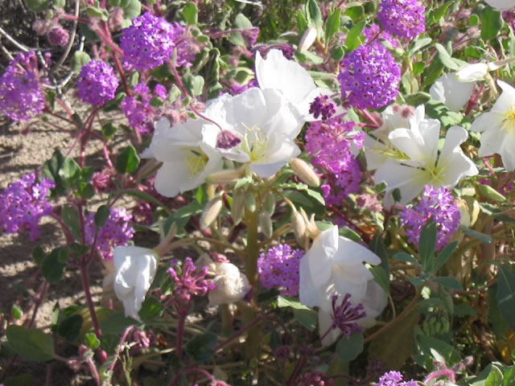
Ocotillo Express wind shares a 5-mile border with Anza Borrego Desert State Park. The Park Service suppressed a report on negative impacts on the park. How much lost tourism revenues will there be?

Slide 24
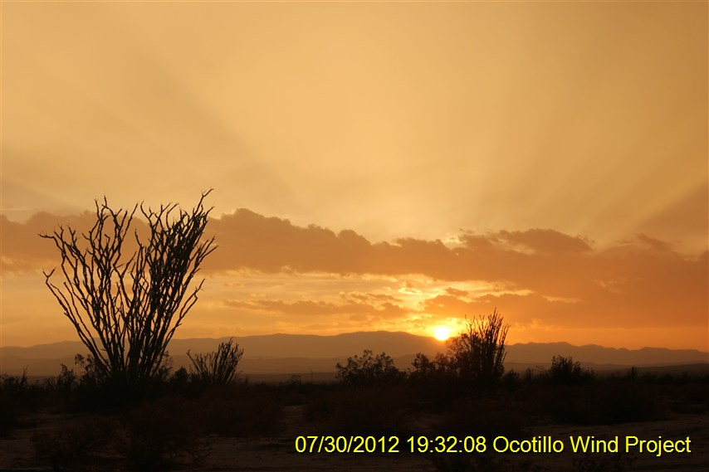
When photographer Jim Pelley bought his home in Ocotillo, he was told lands on 3 sides were protected federal and state preserves that could never be developed. Here is his view then, and now.

Slide 25
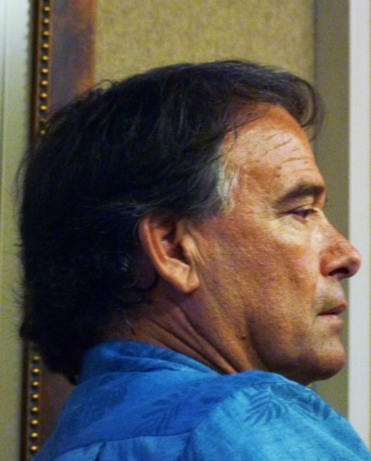
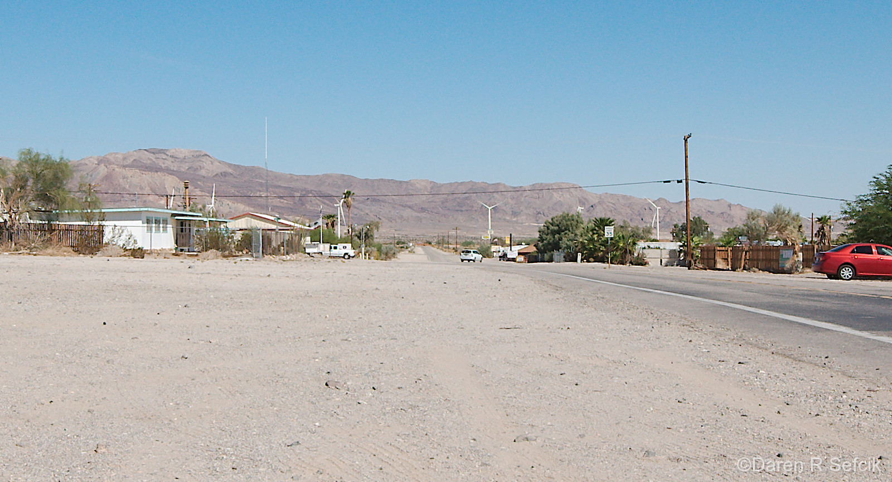
Pattern refuses to compensate for lost property values.
An appraiser who studied homes near wind farms says they lose 40% of their value even several miles away. The closest turbine is just 1500 feet from Jim’s house-and he’s surrounded by them on 3 sides.

Slide 26
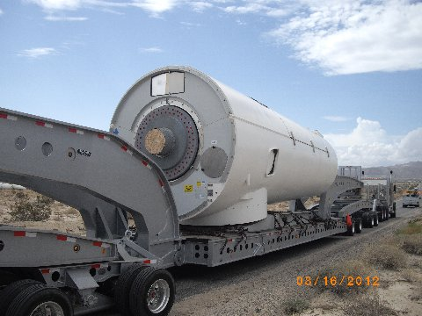
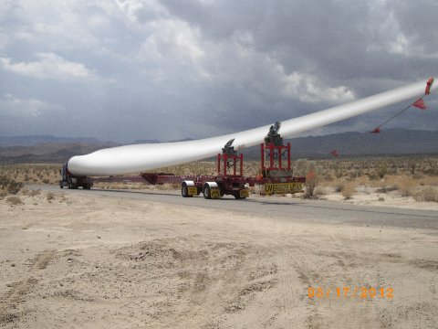
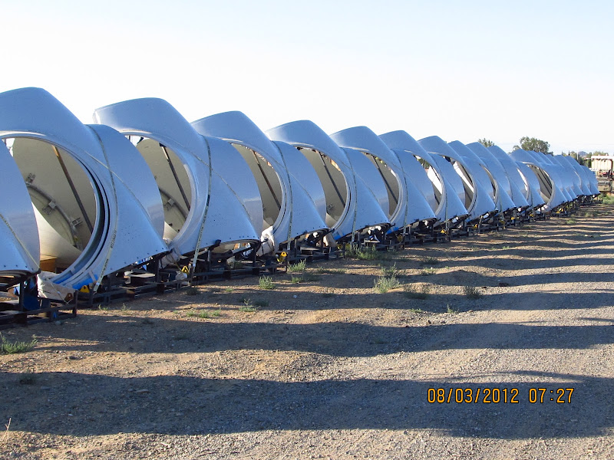
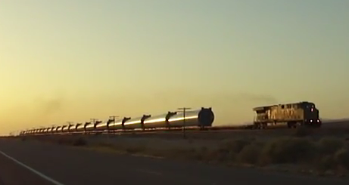
Do we want this in East County?

Slide 27
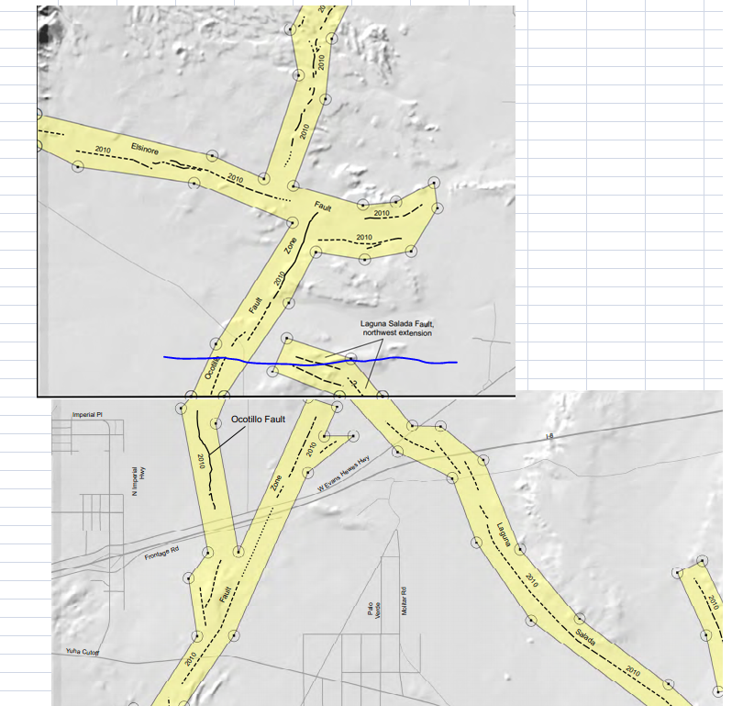
Pattern said its project was within 3 miles of an earthquake fault. Actually the turbines are ON the fault—or very, very close, on both sides.

Slide 28
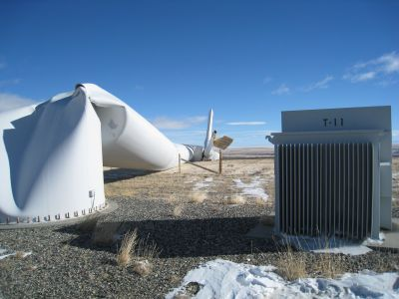
The BLM approved this without seismic engineering to prove it’s safe. What happens if a big quake hits? Experts interviewed say the ground can liquefy, since the turbines are in sand over an aquifer (water). Turbines have collapsed elsewhere from far less stress than a major quake—like this one in Wyoming.

Slide 29
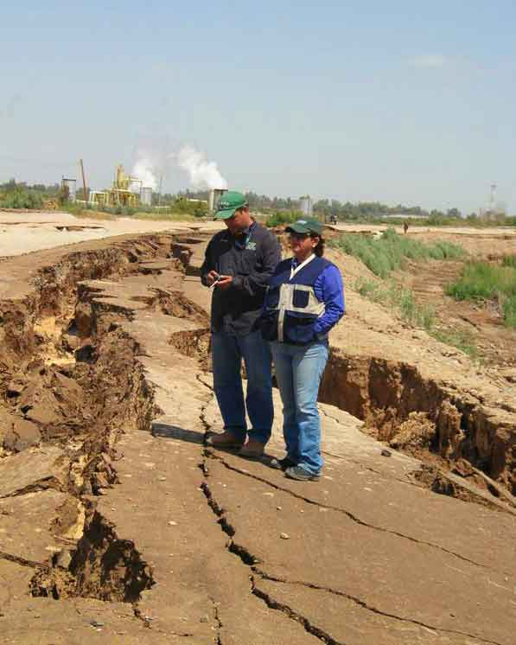
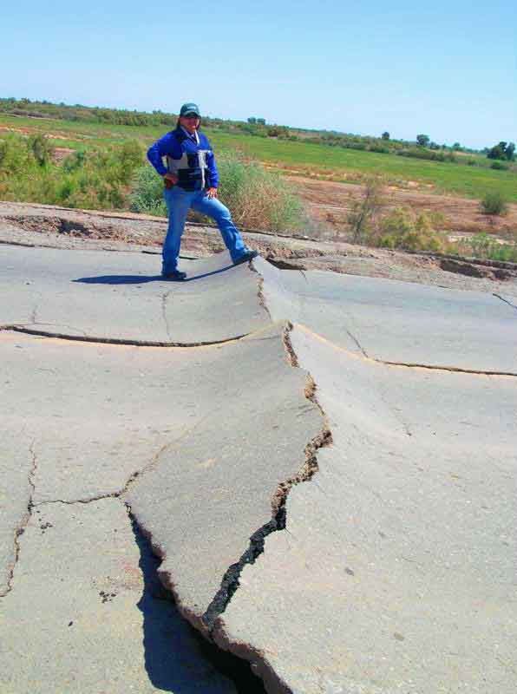
The odds of a major quake striking within 50 miles of Ocotillo within 50 years are 89%. Turbines can throw off blades up to a mile away – each weighing several tons. How can this be safe for people living, driving, hiking or camping nearby?
This summer a quake swarm of over 200 minor tremors struck Ocotillo the day the first turbine was built. The foundation cracked. What happens if the ground ruptures , as it did in Mexico?

Slide 30
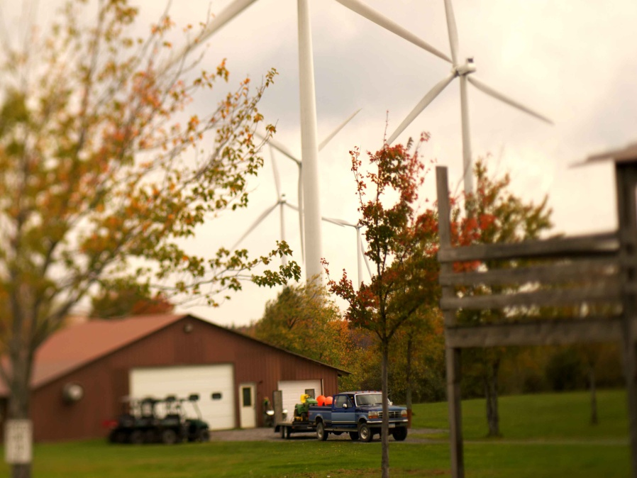
Wind turbines cause serious health harm
Dr. Nina Pierpoint of Johns-Hopkins Medical School documented Wind Turbine Syndrome. Around the world, thousands living near turbines are ill. Symptoms include heart palpitations, ear pain and pressure, nosebleeds, headaches and more. Turbines are noisy, but the infrasound you don’t hear is more dangerous. Infrasound is documented to harm whales and other animals. Long-term it may cause Vibracoustic Disease including organ damage.
Some families near turbines have fled their homes, unable to live there anymore.

Slide 31


Stray voltage is dangerous, too
In Campo, stray voltage/ground current 1,000 times higher than normal was measured inside Manzanita Indians’ tribal hall, church and homes.
60 Manzanita Indians near Kumeyaay Wind are ill with cancer or other ailments . They have been accepted into a University of California health study to confirm if turbines made them sick. Yet nothing’s being done to protect them. The owner wants to triple the size of the wind farm—with turbines twice as tall.
.

Slide 32

Why did our County Health Department issue a whitewash report claiming wind turbines don’t cause health problems? How could they rely on outdated and discredited data and ignore 60 ill Native Americans right here?
Campo’s wind farm blew apart in a 2009 storm. Every turbine blade was replaced. Debris was hurled a mile away. Why? Nobody will say. Rusted debris still litters fields.
This is a pattern. Pattern’s predecessor built Campo’s Kumeyaay Wind, which SDG&E called a “success story” in its application to the CPUC for Ocotillo.

Slide 33

Ranchers near turbines have reported high rates of miscarriages and stillbirths in livestock. Some chickens near turbines lay eggs with no shells. Herds of goats and cattle near turbines have died mysteriously.
How safe are turbines near pregnant women? We don’t know, because no one’s ever tested their safety—not even on animals.

Slide 34


WIND TURBINES ARE FIRE HAZARDS
Each contains over 200 gallons of flammable lubricating oil
Turbines malfunction and burst into flames
They are also giant lighting rods
Wind turbines have cause at least 190 fires, including wildfires
Iberdrola, developer of Tule Wind, won’t tell us what make of turbines they will use. Is it Gamesa, which they own part of, and which has had fire problems?

Slide 35


FIREFIGHTERS CAN’T STOP THESE FIRES
Rural firefighters’ ladders can’t reach 500-foot-tall wind turbines
It’s too dangerous to fight fires under whirling blades
Air drops of fire retardant chemicals work best at 100-150 feet. They can’t use these over tall turbines.

Slide 36

Tule Wind is near where the Harris Fire started, fueled by 100 mph winds, and very near where the Shockey Fire just left 11 families homeless and killed an elderly man. If they can’t fight fires now, how can they possibly stop a fire fueled by all that oil in those turbines?
A FIRE THAT STARTS AT AN EAST COUNTY WIND FARM COULD BURN ALL THE WAY TO THE SEA!

Slide 37


How much energy do turbines actually save?
In Ocotillo the wind speed is only a class 2, below the minimum federal standard for viability. So how did Pattern Energy get the right to destroy federal land with our tax dollars?
Protesters offered to pay any child who could fly a kite for one minute. Nobody could. It’s a wind project with no wind.

Slide 38

Wind turbines use fossil fuels!
Turbines are often manufactured overseas in coal-fired plants.
How much fuel does it take to make them?
How much fuel does it take to ship each 100-ton turbine overseas?
Then transport them on trains? Each turbine takes 10 trucks to deliver. How much fuel to bulldoze a desert or blast tops off mountains? To build all the roads, substations, and power lines?
Now we’re told we need gas “peaker” power plants for “when the wind doesn’t blow.”
Wind projects also destroy forests/plants that absorb greenhouse gases.
ARE THEY REALLY GREEN AT ALL? OR IS IT JU$T THE MONEY?

Slide 39

The new federal fast-track process takes away our voices.
People in Ocotillo and McCain Valley areas tried everything. They couldn’t stop these projects.
Before the approvals:
Their testimony was ignored by public officials.
People weren’t allowed to speak at a key BLM meeting.
Huge concerns raised were not addressed in the EIR.
The EIR was 5,000 pages. There wasn’t time to read it.
One lawyer got notice of major changes just an hour before the project was approved.
Even pleas from Reps Filner and Hunter were ignored.

Slide 40


After the approvals:
People staged protests and held a funeral for the desert.
Indians held a wake for their lost ancestors.
Many lawsuits were filed. You can’t file until after a project is approved but construction starts the next day. With court backlogs, TRO requests took months to be heard. By then, the Ocotillo project was largely built.

Slide 41

This can happen here, too.
It’s happening across America and around the world.

Slide 42

Why is this happening?
It started with Dick Cheney and those secret meetings with energy executives. Remember ENRON? The Bush administration opened public lands up as “energy corridors” including much of East County – it’s how we got Powerlink through Cleveland National Forest and formerly protected BLM lands.

Slide 43

The Obama administration expanded that in its quest for renewable power to stop global climate change. Just this week, the President announced he wants to open even more public lands.
Some say the fix is in. David Hayes, former lobbyist for Sempra/SDG&E, is deputy secretary of the Interior.
Mitt Romney would make things even worse. He wants to open up even national parks for oil drilling and fracking.
They cut down a 100-year-old ocotillo forest to build this. Is this how we want our public lands to look?

Slide 44

Ironically, many wind projects built are producing only a small fraction of the power promised. Why is that?
There were no independent verifications of wind speeds, and no analysis of energy savings vs. fossil fuels used to create these boondoggles.

Slide 45


It’s all a big land grab. Follow the money!
Many big wind companies and desert solar firms are now owned by big oil companies and utilities. The Carlyle Group owns Pattern Energy. BP has a solar company trying to build a project in Jacumba. That gas peaker plant proposed at Mission Trails for when the wind won’t blow? It’s owned by Goldman Sachs.
Big banks and financial interests are in cahoots with oil and utility companies to take our public lands—paid for with our taxpayer money in the form of production tax credits and subsidies.

Slide 46

There are problems with desert solar, too.
They scrape bare thousands of acres, destroying habitat and Native American sacred places.
The military warns that certain types of large-scale solar can interfere with aircraft radar and even attract a heat-seeking missile .
Plus they need more power lines built to connect to remote locations.
SO WHAT ARE THE ALTERNATIVES?

Slide 47

Climate change is a serious concern. But there are better choices.
The world’s top climate scientists agree that we are at a tipping point.
But we don’t have to destroy the earth to save it. There are much better solutions!
Even if you’re a skeptic on climate change, locally generated solar on rooftops and parking lots makes sense economically.
Solar installers in San Diego make $20 to $40 an hour. We can create good-paying jobs and rebuild our economy if we just stop subsidizing corporate boondoggles! We can even make it work without subsidies.

Slide 48

Germany has less sunshine than the U.S., but has much more solar. Why?
Germany gives incentives to homeowners and business owners – not powerful corporations. They have feed-in tariffs. We don’t.
They allow homeowners and business owners who generate more power than they use to sell it back to the grid—and make a profit. In California, utility companies have thus far blocked legislation to allow this here.
San Diego has among the highest fees for solar permits. Let’s change that.
We also need a PACE program, so there will be no up-front costs to install solar. You could pay for it over time through property taxes—using savings on your energy bill. No tax dollars would be needed.

Slide 49


Vertical axis wind turbines are also options.
These are small in scale, don’t kill birds, make loud noise or harm health. They can be installed atop homes or office buildings, or on the ground. These are common in parts of Europe.

Slide 50

How do we break the utilities’ stranglehold on power? Through competition!
Engineer Bill Powers is launching a local energy cooperative called a community choice aggregate (CCA).It will compete against SDG&E. You can choose where to buy power.
The cooperative will only buy locally generated, clean energy. It will NOT buy from industrial-scale wind, desert solar, or fossil fuel plants. All power will come from rooftop and parking lot solar, vertical axis wind or other sane, clean choices. Mayoral candidate Bob Filner, a Democrat, and Supervisor Dianne Jacob, both support this. Now that’s what I call green!

Slide 51

WHAT YOU CAN DO TO SEEK SAFE, SANE “GREEN” ENERGY POLICIES
Tell our elected officials and candidates at all levels:
Make energy projects on public lands a last choice, not a first choice.
Require that the first choices be affordable energy options with the least negative impacts-- such as rooftop solar or vertical axis wind. Give priority to projects that help people—not big corporations.
Give communities a choice in how to produce renewable energy and/or conserve. Incentivize rooftop solar through PACE programs, low fees and other measures.
Support conservation! Retrofit and weatherize buildings in East County to cut energy use and create jobs.
Immediately ban industrial wind turbines in fire-prone areas like East County, which is now in the worst drought since the 1930s.
Require a life-cycle cost/benefit analysis of all projects receiving tax dollars or proposed on public lands.

Slide 52
FEDERAL
Stop using our tax dollars to destroy public lands! Oppose extending wind production tax credits.
Demand oversight! We need monitors not paid for or hand-picked by wind developers on site at all time. Hold hearings on the abuses occurring.
Stop fast-tracking! Hold hearings on problems it’s caused. Allow more time for public input and adequate time for temporary restraining orders to be heard before construction commences.
STATE
Change incentives and mandates at the state level. Renewable energy goals are good, forcing industrial wind turbines that destroy communities and public lands are bad. Introduce a comprehensive bill that incorporates the points above!
Ask state representatives to ask federal representatives to take the above actions.
COUNTY
Oppose the proposed County Wind Ordinance. Protect our communities and wild places!
Support a local energy cooperative so we will have an alternative to SDG&E, which wants ratepayers--ot shareholders--to pay for wildfires it caused and a failing nuclear plant.
Ask county officials to ask state and federal officials to take the above actions.

Slide 53

The wind industry now wants to build in less and less windy areas, with even taller turbines—1,000 feet tall now in Europe.
If we don’t work together to stop this, this could happen where you live...even if you’re not in East County!

Slide 54

If you have questions, or would like this presentation for your organization, contact editor@eastcountymagazine.org or call (619)698-7617.
If you would like to volunteer to help build a new website, www.SavePublicLands.org (coming soon) please let us know. Find more information on these issues in the “Green Living” section at www.EastCountyMagazine.org.

