Slide 1
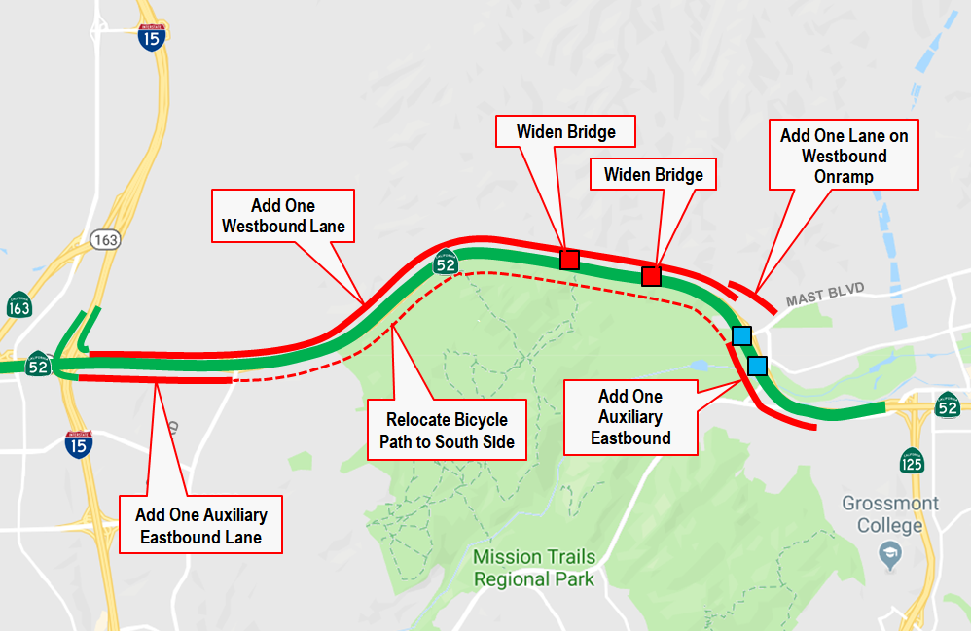
INFRA Grant Application

