Slide 1
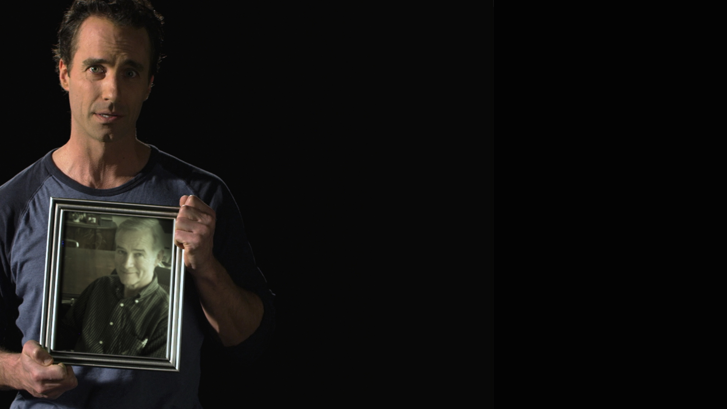
SUICIDE DEATHS
SAN DIEGO COUNTY
Source: County Health and Human Services Agency-Medical Examiner Database 2007-2011
Up2SD.org (888) 724-7240

Slide 2
SUICIDE RATE
SAN DIEGO COUNTY
Per every 100,000 people
Source: County Health and Human Services Agency-Medical Examiner Database 2007-2011
Up2SD.org (888) 724-7240

Slide 3

2011 SUICIDE
AGE BREAKDOWN
Source: County Health and Human Services Agency-Medical Examiner Database 2011
Up2SD.org (888) 724-7240

Slide 4

2011 SUICIDE
ETHNIC BREAKDOWN
Total Suicides = 392
Up2SD.org (800) 479-3339

Slide 5
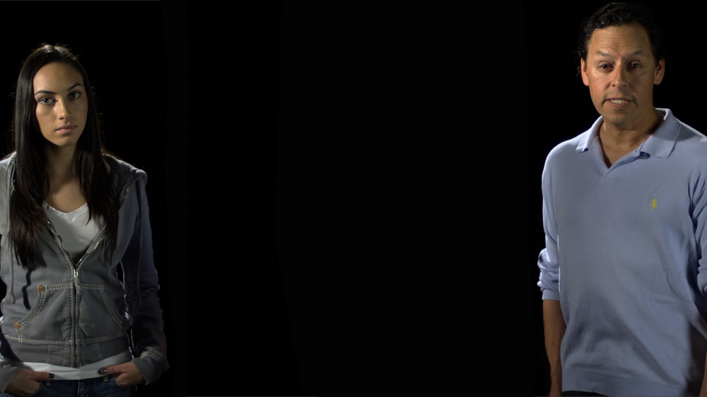
2011 SUICIDE
GENDER BREAKDOWN
Total Suicides = 392
Source: County Health and Human Services Agency-Medical Examiner Database 2010
Up2SD.org (888) 724-7240

Slide 6
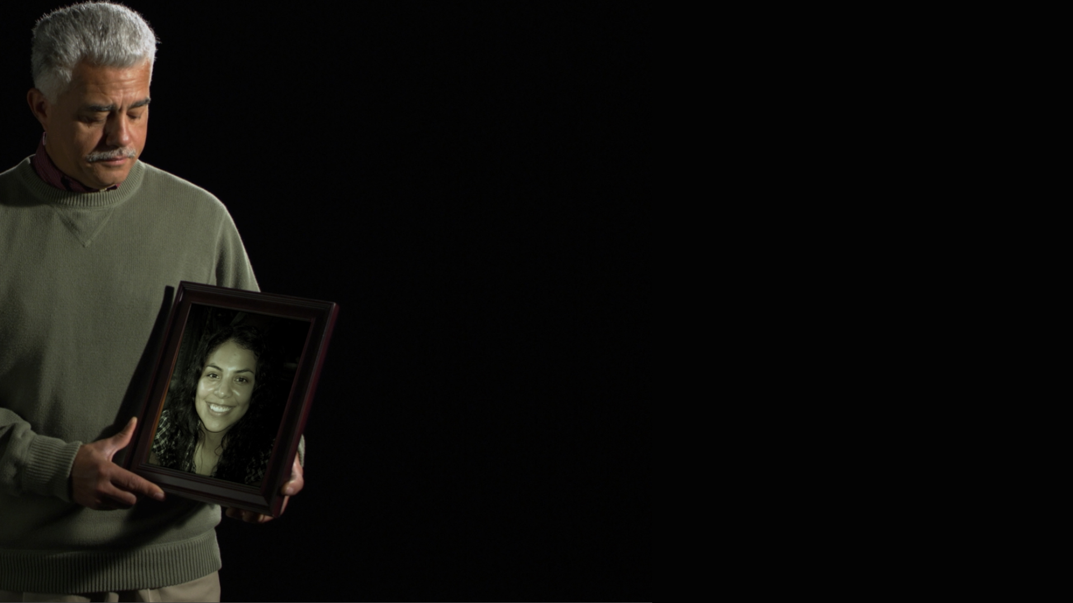
SUICIDE WARNING SIGNS
Talking of hurting or killing oneself
Hopelessness or helplessness
Divorce, separation, stress on family
Loss of health
Loss of job or home
Increased alcohol or drug use
Isolation from family and friends
Daring or risk-taking behavior
Up2SD.org (888) 724-7240

Slide 7

HELPING A SUICIDAL PERSON
Ask: Are you having thoughts of suicide?
Listen
Take it seriously
Suicidal behavior is a call for help
Don’t leave person alone
Urge professional help
Give and get help right away
11.5
Up2SD.org (888) 724-7240

